Slide 1

MOVIE RECOMMENDATION SYSTEM WITH MACHINE LEARNING
Group No: 10
Akhil Namboodiri - 1814042
Jaykumar Panchal - 1814044
Pankti Nanavati - 1814045

Slide 2
PROBLEM STATEMENT
In today’s society, online recommendation systems are practically prevalent. Almost every consumer-facing website we visit, from Flipkart to Netflix, offers us some sort of recommendation. It might be anything from Facebook friend recommendations to books on Flipkart or articles read on a news website. The immediate and concrete benefits of a good recommendation system for salespeople are increased sales and money generation. Users who might be the purchasers as well are frequently overwhelmed by a plethora of choices and possibilities in online business experiences, while also having limited resources and time to devote to the choosing process. In reality, developing a prediction system for a movie database is extremely closely related to developing a recommendation system. The movies that a user is likely to see will be the recommended products in this case. We aim to develop a prediction system that predicts the movie preferences for an unknown user based on some factors. As described in the problem statement, we essentially aim to predict whether a user is likely to watch a movie or not.

Slide 3
INTRODUCTION
Recommendation systems filter the preferences for the user from huge data and provide the relevant information only.
It helps the user find the content which interests him/her the most based on a number of factors making the experience personalized to each user.
User preferences, several factors like demographic details, product description, profile, browsing history, and so on help build up and identify well matched pairs between user and items using algorithms and predictive modelling.
Examples where recommendation systems are used are Amazon, Netflix, Social Media Platforms, News Applications etc.

Slide 4
WHAT ARE RECOMMENDATION SYSTEMS?
Recommender systems are software program that make recommendations to users based on a variety of parameters. These systems forecast the most likely product that users will buy and that they will be interested in.
NEED:
Minimizes the cost of browsing, finding and selecting the product from an online platform.
Enhance the decision-making process thereby increasing the product sale and the revenue generated for the service provider.
Saves people’s time and effort in finding their choices in a complex domain easily.

Slide 5
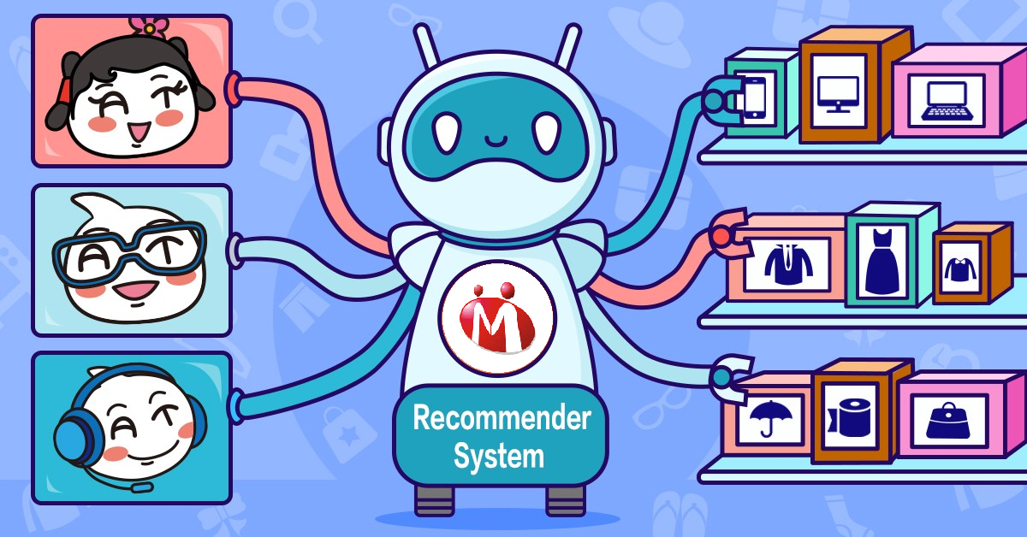
MACHINE LEARNING ALGORITHMS USED IN RECOMMENDATION SYSTEMS
Support Vector Machines
Naive Bayes
Content based filtering
Collaborative filtering
Hybrid filtering
Clustering approaches like K-Means, KNN
Logistic Regression

Slide 6
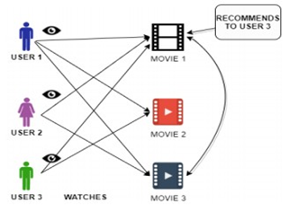
MACHINE LEARNING ALGORITHMS
Collaborative Filtering:
Collaborative filtering is a method wherein the attributes of each item are not taken into account. It uses the preferences provided by other users to provide recommendation.
Does not require domain knowledge, it also helps the user discover and find new items and interests.
It needs to have enough information to start recommending i.e., cold start problem, it cannot handle new users and new items effectively and unpopular tastes are not supported strongly.

Slide 7
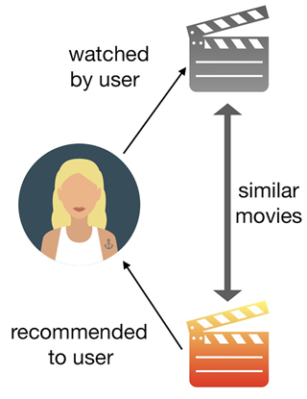
MACHINE LEARNING ALGORITHMS
Content Filtering:
Content-based frameworks analyse the depiction and features of an item, as well as the client’s preferences.
It takes into account user’s previous ratings, comments, likes and dislikes of the various items.
It does not necessitate the use of data from other users and it is also specific to each user and hence can be applied to large number of users.
Limited to only existing interests of the user and this method requires a lot of domain knowledge since the attribute representation of the various items is hand-engineered.

Slide 8

MACHINE LEARNING ALGORITHMS
K-Means Clustering:
Used where Collaborative filtering and Content based filtering approaches fail to last longer while developing larger recommendation systems. K-Means is the first suggestion to overcome this problem.
It gives us a technique to characterise and categorise data when we don’t know how to do so beforehand.
The measure for generating recommendation will be on the basis of similarity of two items like vector distance between these items.
It is relatively simple to implement and efficiently scales well to large data sets.

Slide 9
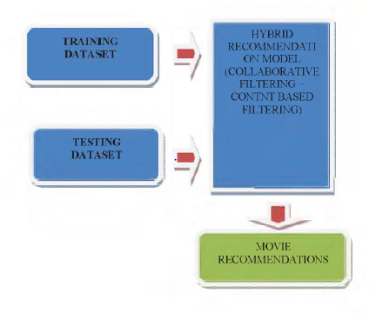
IMPLEMENTATION AND RESULTS
Hybrid model of Collaborative Filtering and Content Based Filtering
The first implementation uses a hybrid combination of both the collaborative and content based filtering techniques.
The dataset used is the Movielens dataset.
By applying combination of collaborative and content based filtering technique, the system is able to effectively recommend movies that the users may like. Companies working in entertainment industry are utilizing these types of recommendation model to increase their sales.
The hybrid model helps recommend users the movies they may like.

Slide 10
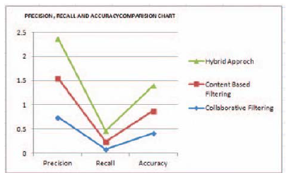
IMPLEMENTATION AND RESULTS
Performance comparison among purely content based, purely collaborative and hybrid recommendation model shows that the hybrid model performs more than other two models. The performance is compared based on precision, recall and accuracy.
From the graph shown, we can clearly see how the hybrid model out performs better than either of the collaborative and content based filtering models used independently.
Performance is measured using precision ,recall and accuracy.

Slide 11
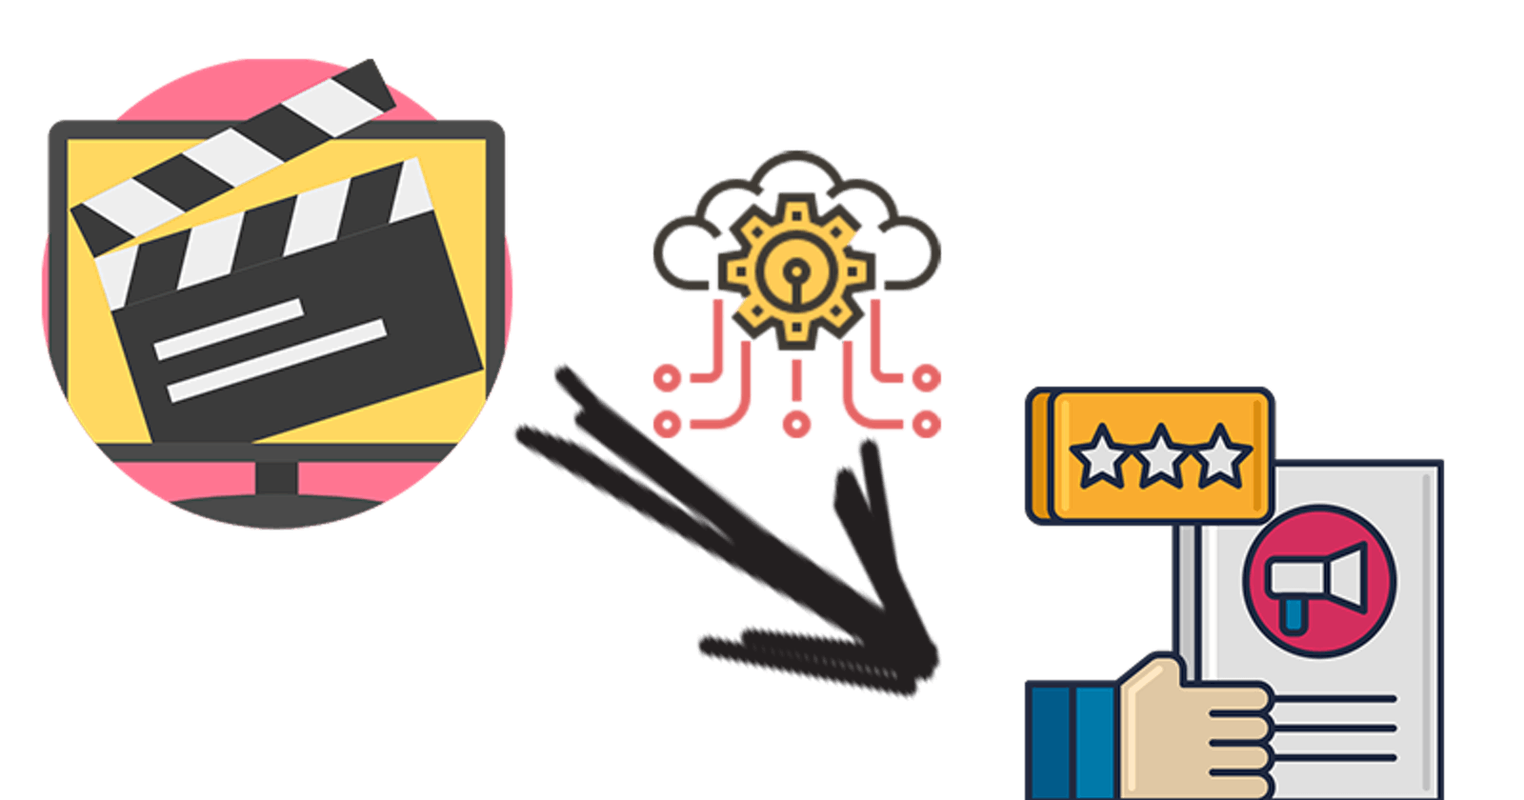
IMPLEMENTATION AND RESULTS
B) K-Means Clustering
K-Means Clustering along with K-Nearest Neighbor is implemented on the Movielens dataset in order to obtain the best-optimized result.
In the existing technique, the data is scattered which results in a high number of clusters while in the proposed technique data is gathered and results in a low number of clusters.
The process of recommendation of a movie is optimized in the proposed scheme. The proposed recommender system predicts the user’s preference for a movie on the basis of different parameters. This process optimizes the process and having lower RMSE.

Slide 12
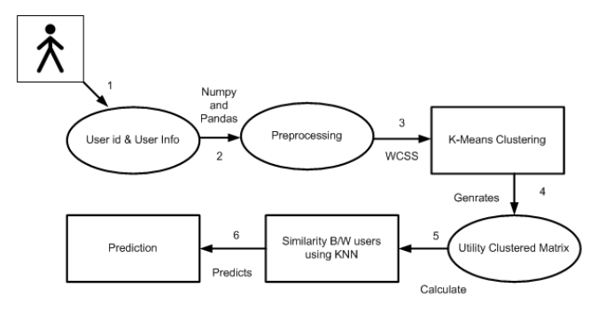
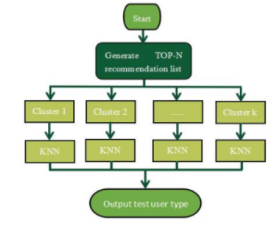
IMPLEMENTATION AND RESULTS
This technique uses K-means clustering and K-nearest neighbours. The implementation consists of data collection, data preparation, model creation, model training and model testing.
In the data collection step, the right dataset is chosen. Here, the dataset chosen is the movielens dataset from Kaggle.
The data preparation step includes data pre-processing. Also, a utility matrix is created which shows the movies rated by a user which is done by dividing the user data and movies data into separate dataframes.

Slide 13
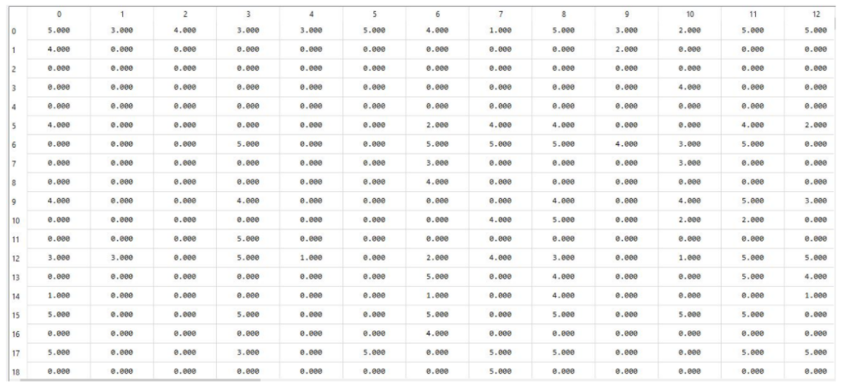
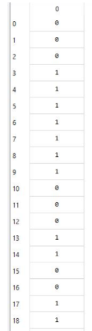
IMPLEMENTATION AND RESULTS
Utility Matrix
WCSS

Slide 14
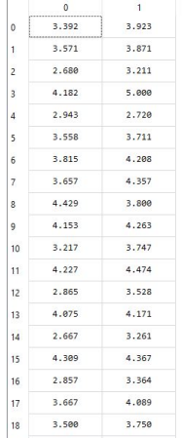
IMPLEMENTATION AND RESULTS
In the data creation step, the appropriate number of clusters i.e. k are selected for using the WCSS (Within-Cluster Sum of Square) method. This is used to find the right no clusters so that K-means clustering can be applied in the movie.
After applying K-means clustering, a utility clustered matrix is build which defines average rating the user gives to each cluster.
Utility Clustered Matrix

Slide 15
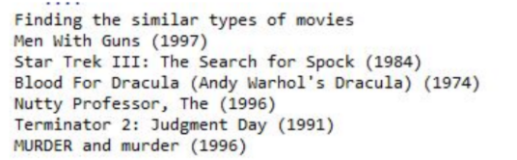
IMPLEMENTATION AND RESULTS
Using the utility clustered matrix and Pearson correlation similarity between the users are calculated as shown in the next slide.
Finally KNN uses the utility clustered matrix and similarity to predict the movies for input user.

Slide 16
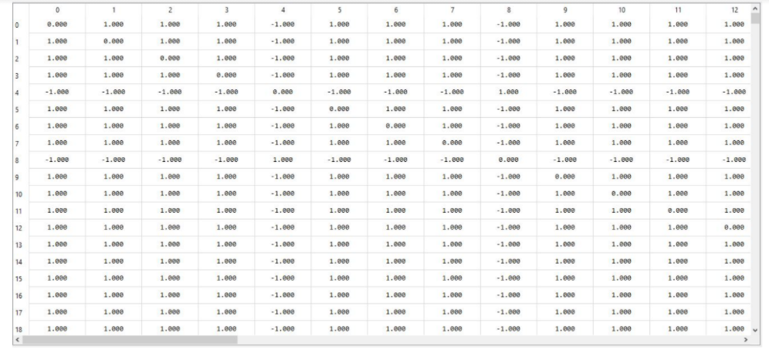
Similarity Matrix

Slide 17
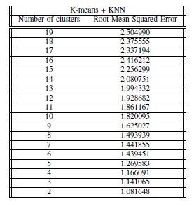
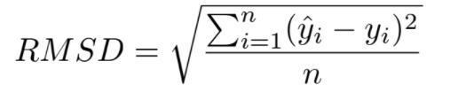
IMPLEMENTATION AND RESULTS
After training, the model is tested on the testing data. Also, the model is evaluated using some metric. Root Mean Squared Error (RMSE) will be the metric. The results table below shows the RMSE obtained after using various number of clusters.

Slide 18
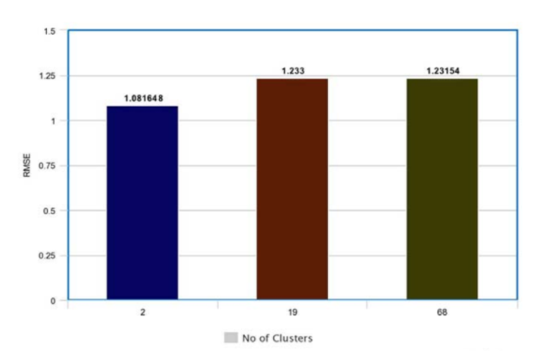
The graph compares the RMSE value for existing technique with the RMSE value of the proposed technique. The X- axis represents the No of Clusters and Y-axis represents the RMSE values.
It is seen from the graph that for the existing technique the RMSE value is 1.23154 for cluster equal to 68, RMSE value using proposed technique is 1.233 to 19 clusters
and RMSE value using proposed technique is 1.081648 to 2
clusters.

Slide 19
DEMONSTRATION
Github link for the Jupyter Notebook File:
https://github.com/Pankti-Nanavati/ML_IA2_EXP8-Movie-Recommendation-

Slide 20
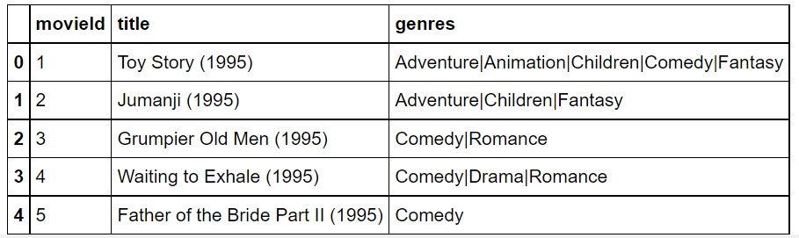
DEMONSTRATION RESULTS
Displaying the movie data present in the dataset

Slide 21
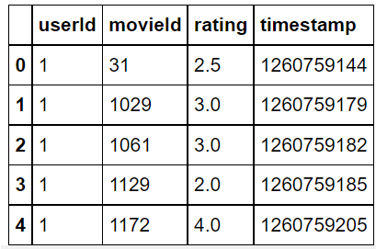

Displaying the ratings data present in the dataset
Number of records present in the dataset in all the tables

Slide 22
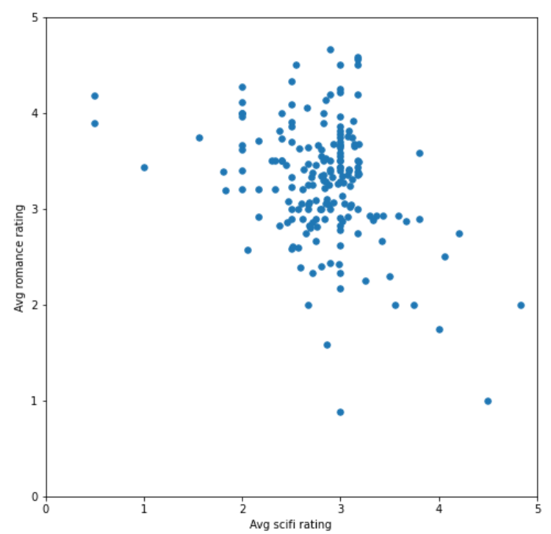
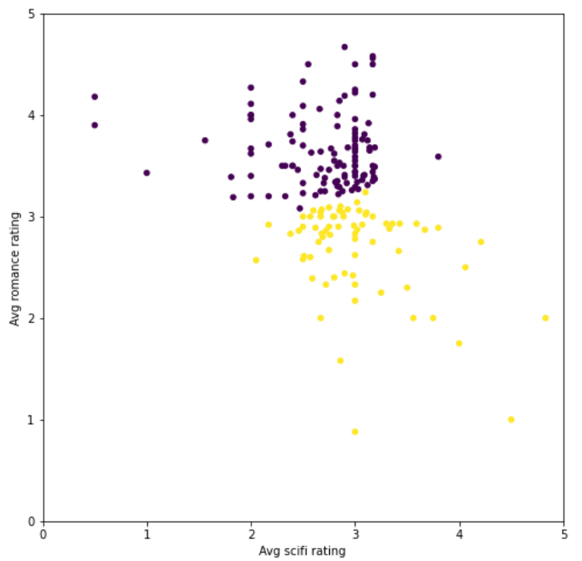
Scatter plot between AVG SCI FI RATING and AVG ROMANCE RATING before clustering
Scatter plot between AVG SCI FI RATING and AVG ROMANCE RATING after clustering with 2 clusters

Slide 23
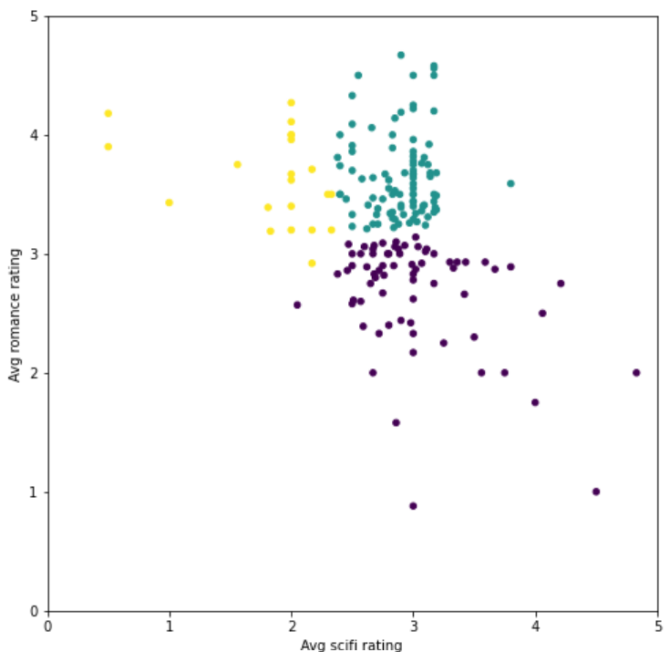
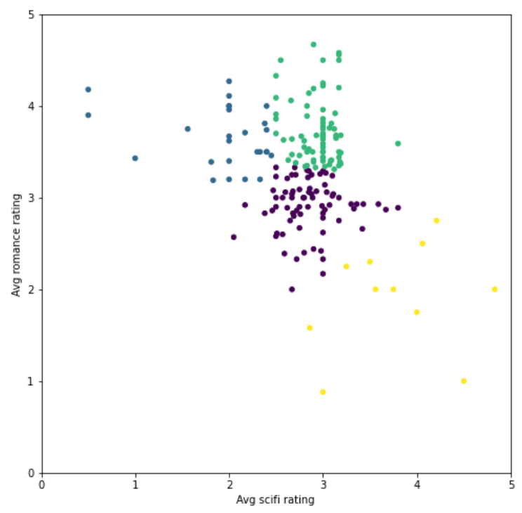
Scatter plot between AVG SCI FI RATING and AVG ROMANCE RATING after clustering with 3 clusters
Scatter plot between AVG SCI FI RATING and AVG ROMANCE RATING after clustering with 4 clusters

Slide 24
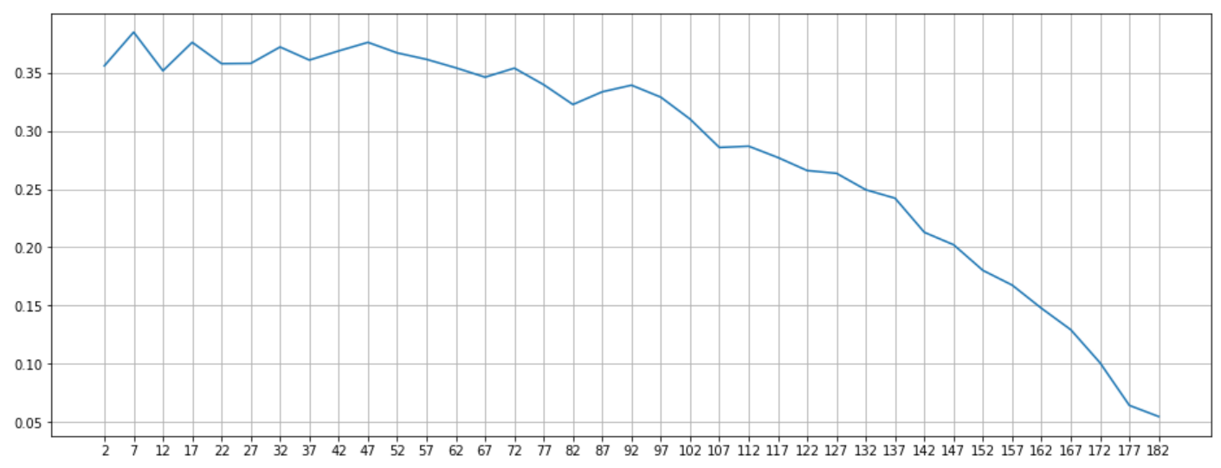
Plot the each value of K vs. the silhouette score at that value

Slide 25
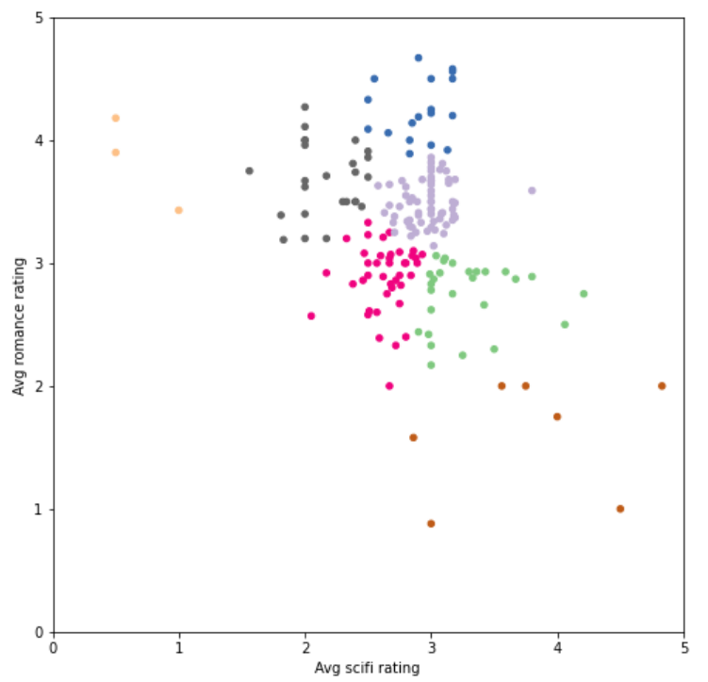
Scatter plot between AVG SCI FI RATING and AVG ROMANCE RATING after clustering with 7 clusters

Slide 26
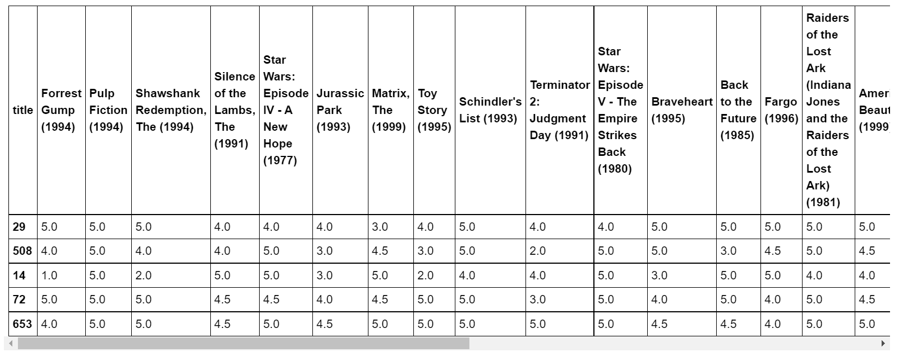
Pre processing and sorting the rating function

Slide 27
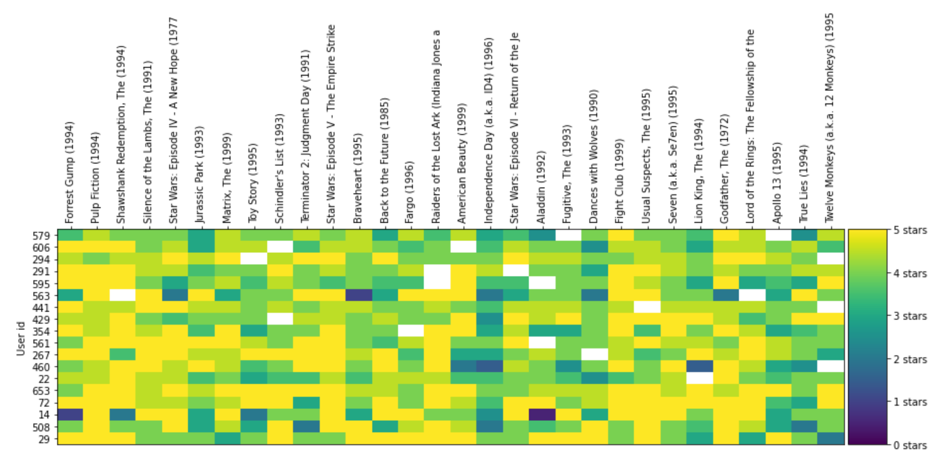
Heatmap for the most rated movies by users

Slide 28
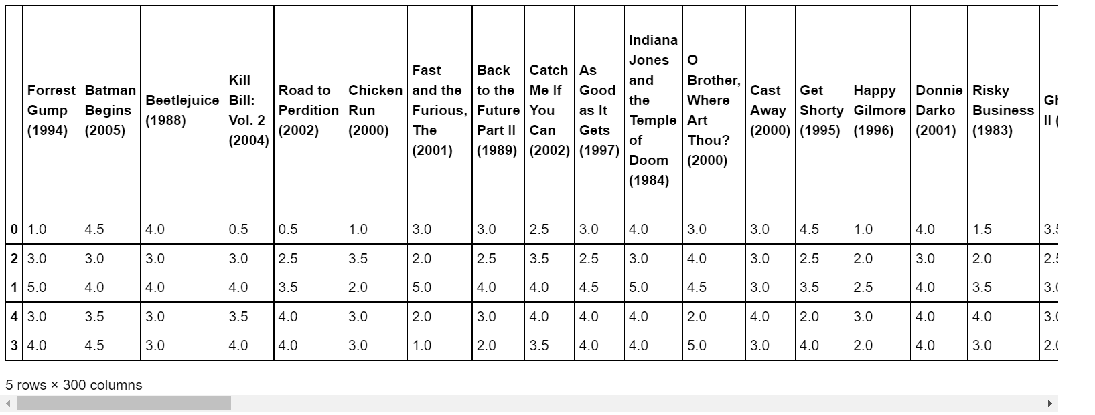
Prediction on the basis of the cluster ID

Slide 29
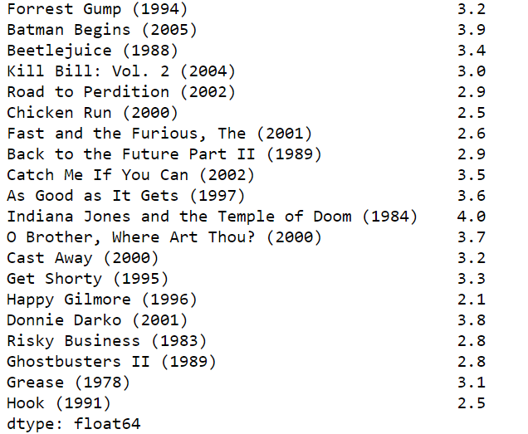
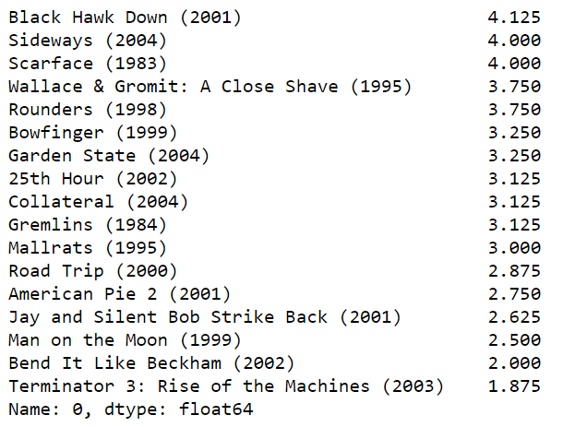
The average rating of 20 movies as rated by the users in the cluster
The average rating of 20 movies as rated by the USER ID 2

Slide 30
CONCLUSION
For this project, we created a K means clustering model which could predict what movie rating would a user belonging to a particular group would give and also recommend movies for the same.
We clustered the users on the basis of their ratings to Romance and Sci Fi movies and after getting the ideal number of clusters which was 7, we performed the recommendation.
Data was collected and correspondingly pre-processed and a Heatmap was used to visualize the correlation between the users and their ratings.
This model can predict as well recommend movies or ratings to the users belonging to a similar group of choice.

Slide 31
REFERENCES
S. C. Mana and T. Sasipraba, “A machine learning based implementation of product and service recommendation models,” in 2021 7th International Conference on Electrical Energy Systems (ICEES), 2021, pp. 543–547.
N. Smitha, D. Anusha, C. Chaithanya, J. Sindhu, R. Tanuja, and H. S. Hemanth Kumar, “A review on movie recommendation system using machine learning,” in 2021 Third International Conference on Intelligent Communication Technologies and Virtual Mobile Networks (ICICV), 2021, pp. 769–773.
R. Ahuja, A. Solanki, and A. Nayyar, “Movie recommender system using k-means clustering and k-nearest neighbor,” in 2019 9th International Conference on Cloud Computing, Data Science Engineering (Confluence), 2019, pp. 263–268.
M. Gupta, A. Thakkar, Aashish, V. Gupta, and D. P. S. Rathore, “Movie recommender system using collaborative filtering,” in 2020 International Conference on Electronics and Sustainable Communication Systems (ICESC), 2020, pp. 415–420.

Slide 32
REFERENCES
G. Sunandana, M. Reshma, Y. Pratyusha, M. Kommineni, and S. Gogulamudi, “Movie recommendation system using enhanced content-based filtering algorithm based on user demographic data,” in 2021 6th International Conference on Communication and Electronics Systems (ICCES), 2021, pp. 1–5.
C. Cai and L. Wang, “Application of improved k-means k-nearest neighbor algorithm in the movie recommendation system,” in 2020 13th International Symposium on Computational Intelligence and Design (ISCID), 2020, pp. 314–317

Slide 33
THANK YOU

